Slide 1
Digital Logic Lecture 08
By Amr Al-Awamry

Slide 2
Combinational Logic 1
A combinational circuit consists of an interconnection of logic gates. Combinational logic gates react to the values of the signals at their inputs and produce the value of the output signal, transforming binary information from the given input data to a required output data

Slide 3
Combinational Logic 2
The diagram of a combinational circuit has logic gates with no feedback paths or memory elements .

Slide 4
Analysis Procedure
one has previous experience and familiarity with a wide variety of digital circuits.To obtain the output Boolean functions from a logic diagram, we proceed as follows:
1. Label all gate outputs that are a function of input variables with arbitrary symbols— but with meaningful names. Determine the Boolean functions for each gate output.
2. Label the gates that are a function of input variables and previously labeled gates with other arbitrary symbols. Find the Boolean functions for these gates.
3. Repeat the process outlined in step 2 until the outputs of the circuit are obtained.
4. By repeated substitution of previously defined functions, obtain the output Boolean functions in terms of input variables.

Slide 5
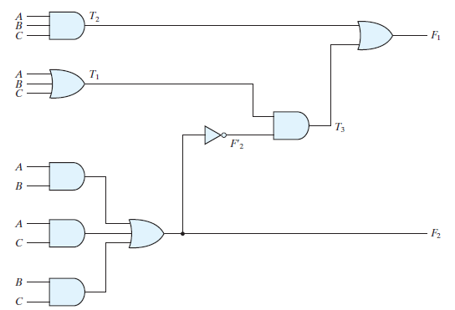
Example 1

Slide 6
Example …. Cont.

Slide 7
Truth Table
The derivation of the truth table for a circuit is a straightforward process once the output Boolean functions are known. To obtain the truth table directly from the logic diagram without going through the derivations of the Boolean functions, we proceed as follows:
1. Determine the number of input variables in the circuit. For n inputs, form the 2^{n} possible input combinations and list the binary numbers from 0 to (2^{n} - 1) in a table.
2. Label the outputs of selected gates with arbitrary symbols.
3. Obtain the truth table for the outputs of those gates which are a function of the input variables only.
4. Proceed to obtain the truth table for the outputs of those gates which are a function of previously defined values until the columns for all outputs are determined.

Slide 8
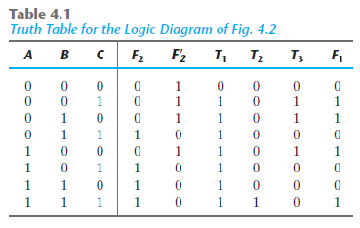
Truth Table for example

Slide 9
Design Procedure
1. From the specifications of the circuit, determine the required number of inputs and outputs and assign a symbol to each.
2. Derive the truth table that defines the required relationship between inputs and outputs.
3. Obtain the simplified Boolean functions for each output as a function of the input variables.
4. Draw the logic diagram and verify the correctness of the design (manually or by simulation).

Slide 10
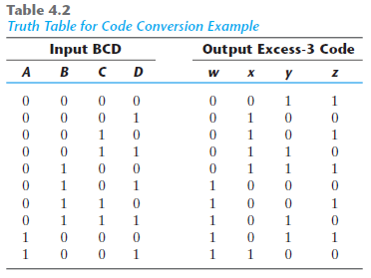
Code conversion example

Slide 11
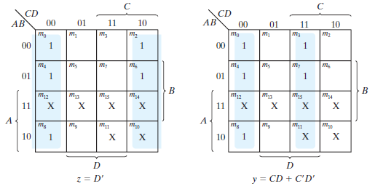
Code conversion k-map 1

Slide 12
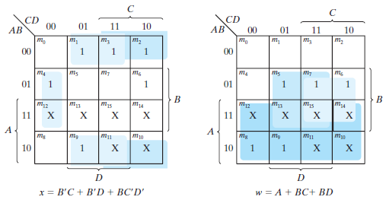
Code conversion k-map 2

Slide 13
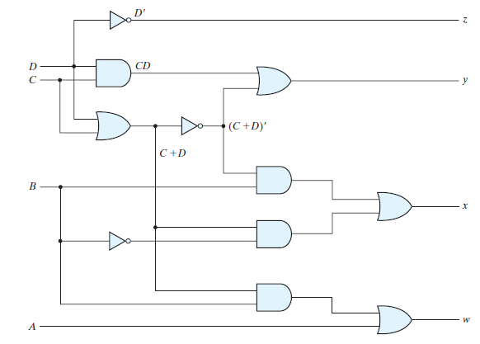
Code Conversion Implmentation

Slide 14
BINARY ADDER–SUBTRACTOR
A combinational circuit that performs the addition of two bits is called a half adder . One that performs the addition of three bits (two significant bits and a previous carry) is a full adder .

Slide 15
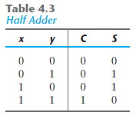
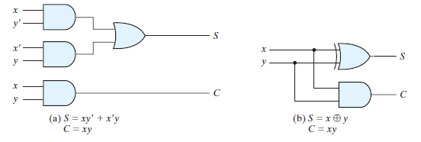
Half Adder

Slide 16
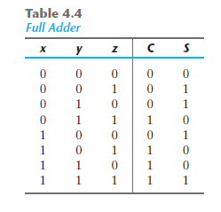
Full Adder

Slide 17
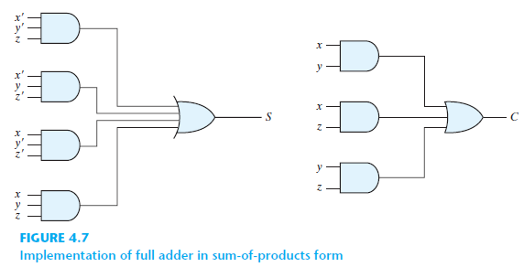
Full Adder Implementation

Slide 18
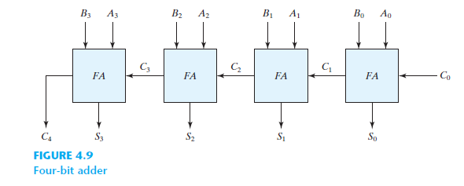
Four bit Adder

Slide 19
Thanks

